Slide 1
King County HOUSING MARKET INSIGHTS
HANDE TOKGOZ UTKU
Date:

Slide 2
Questions about king county real estate market
What are the top 5 data points that impact the prices of homes in the market?

Slide 3
Summary of DATASET USED
The analysis is based on King County (in Washington State) home sales in the years of 2014 and 2015. The dataset has the below fields:
Price
Square foot of living area
Square foot of lot
Square foot of above ground
Square foot of basement
Latitude
Longitude
Year renovated
Year built
Zip code
Date of home sale
Waterfront
View
#Floors
Condition
Grade
* The definitions of the fields can be found in Appendix 1.

Slide 4
Summary of insights
Based on the inferential and descriptive statistics work we have done, the values below has the most impact on housing prices:
Bathroom
Grade
Square foot of lot
Waterfront & View
Year Renovated

Slide 5
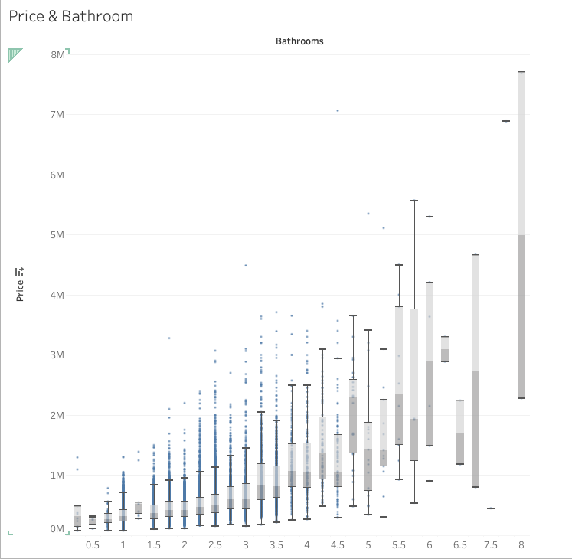
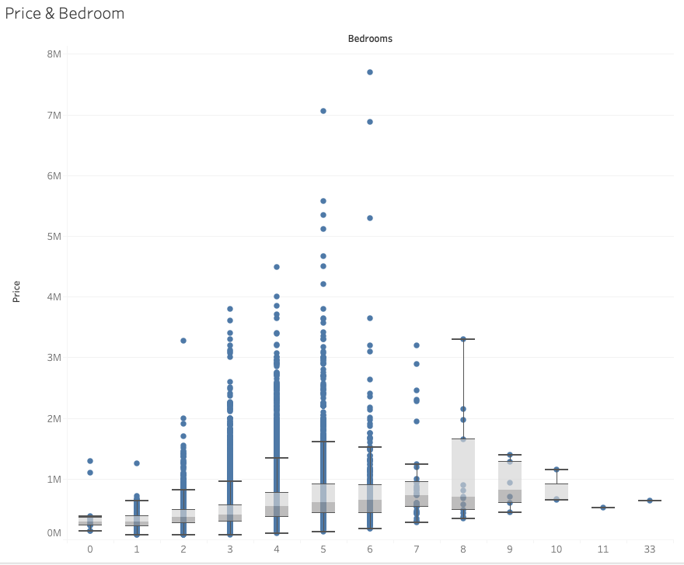
Price & Bathroom/BEDROOM
Number of bathrooms increase the overall home price and price variety
Number of bedrooms increase the overall home price

Slide 6
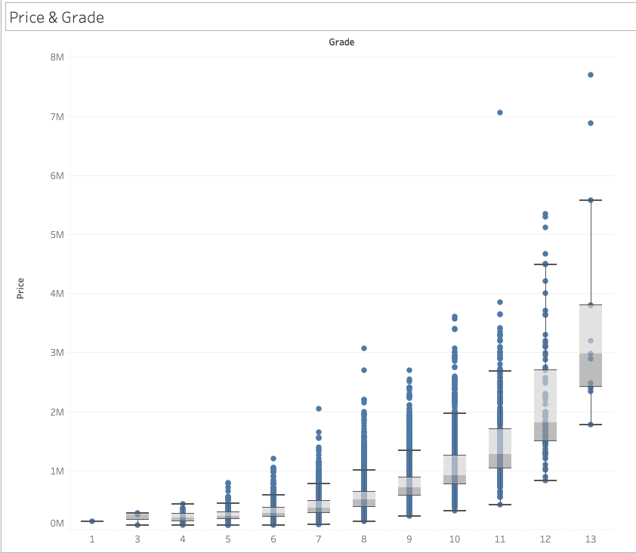
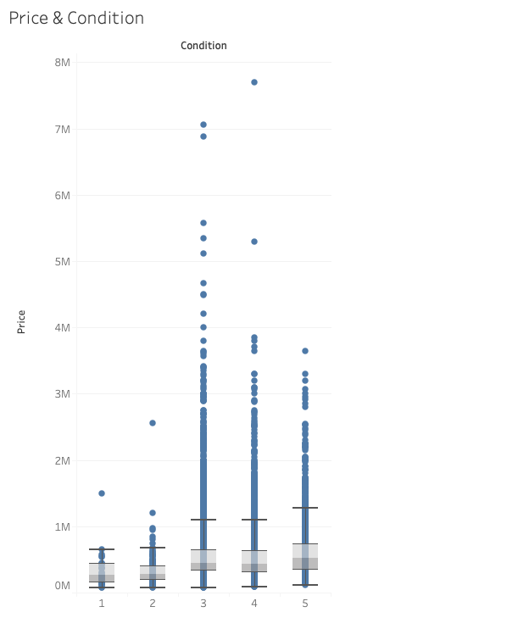
Price & grade/condition
Grade is positively correlated with price, whereas we observe a higher price variety when grade is above 10
Condition has minor impact on price

Slide 7
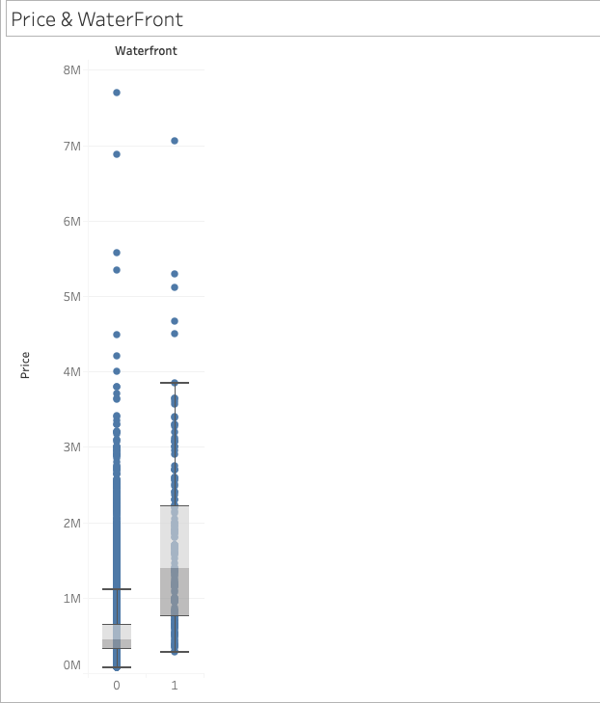
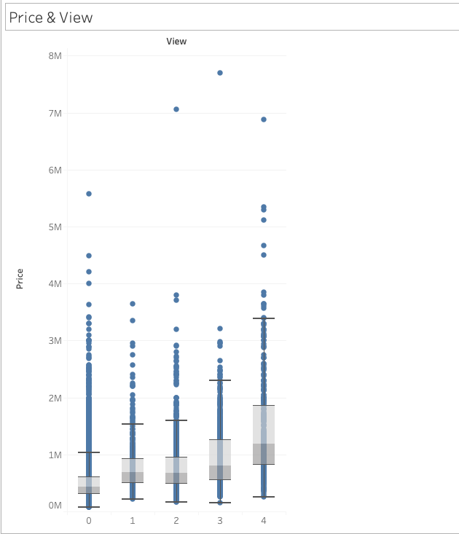
Price & waterfront/view
Waterfront and view are both positively correlated with prices. There is much larger price variety when these metrics are higher

Slide 8
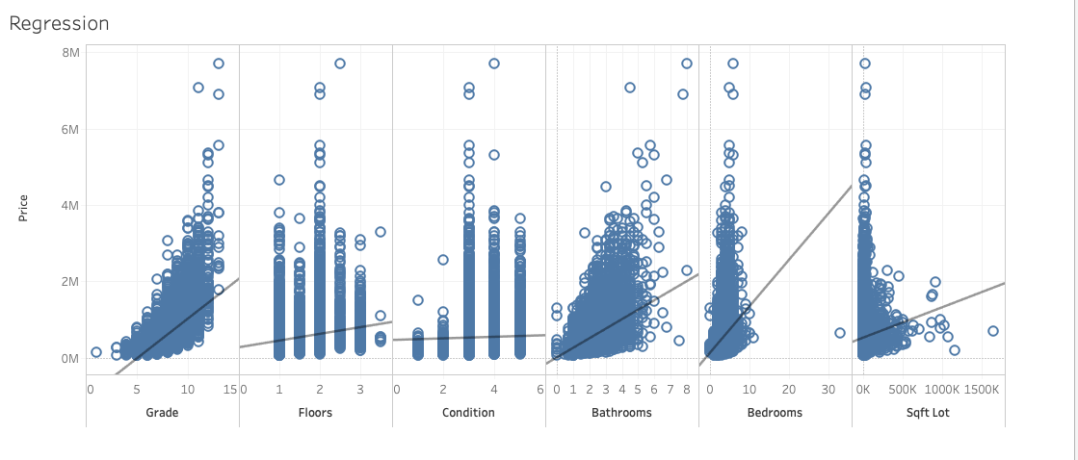
SCATTER PLOTS
Bedrooms and Grade has a high impact on home prices, and condition has the lowest impact among the above six metrics.

Slide 9
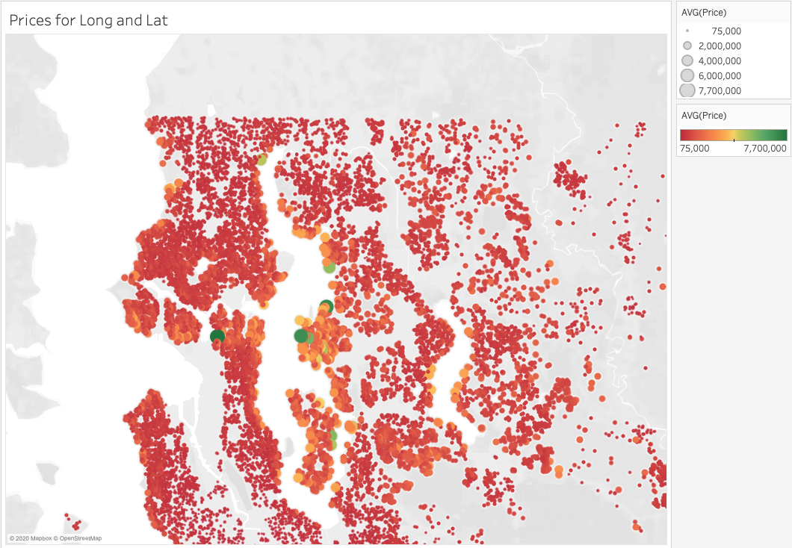
Prices for Longitude & latitude
These three extremely high priced homes are all larger homes with waterfront and view, as we can interpret from their geographic location as well.

Slide 10
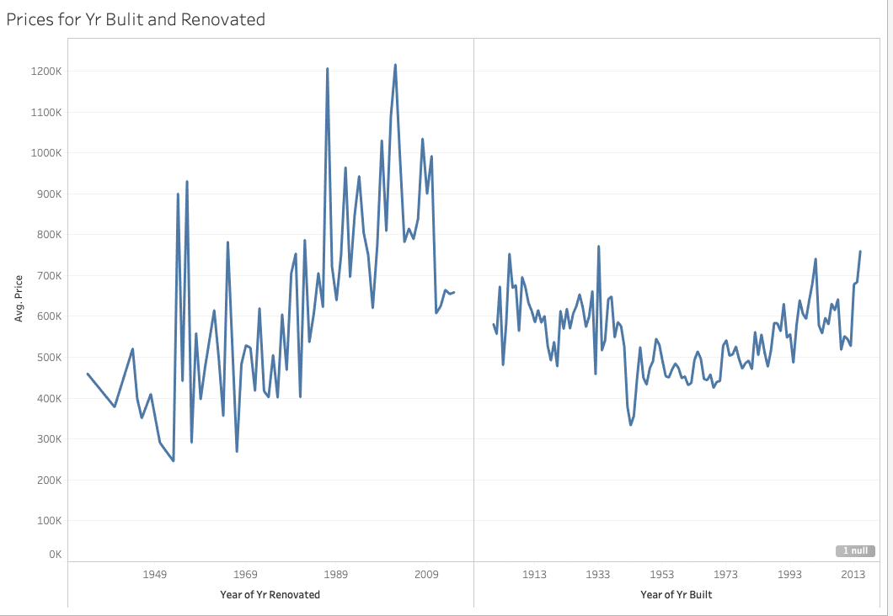
Prices for year built and renovated
Unless the home is built in the last five years, year built has minor impact on price, whereas year renovated is more correlated with price . The newer the renovation, the higher the price.

Slide 11
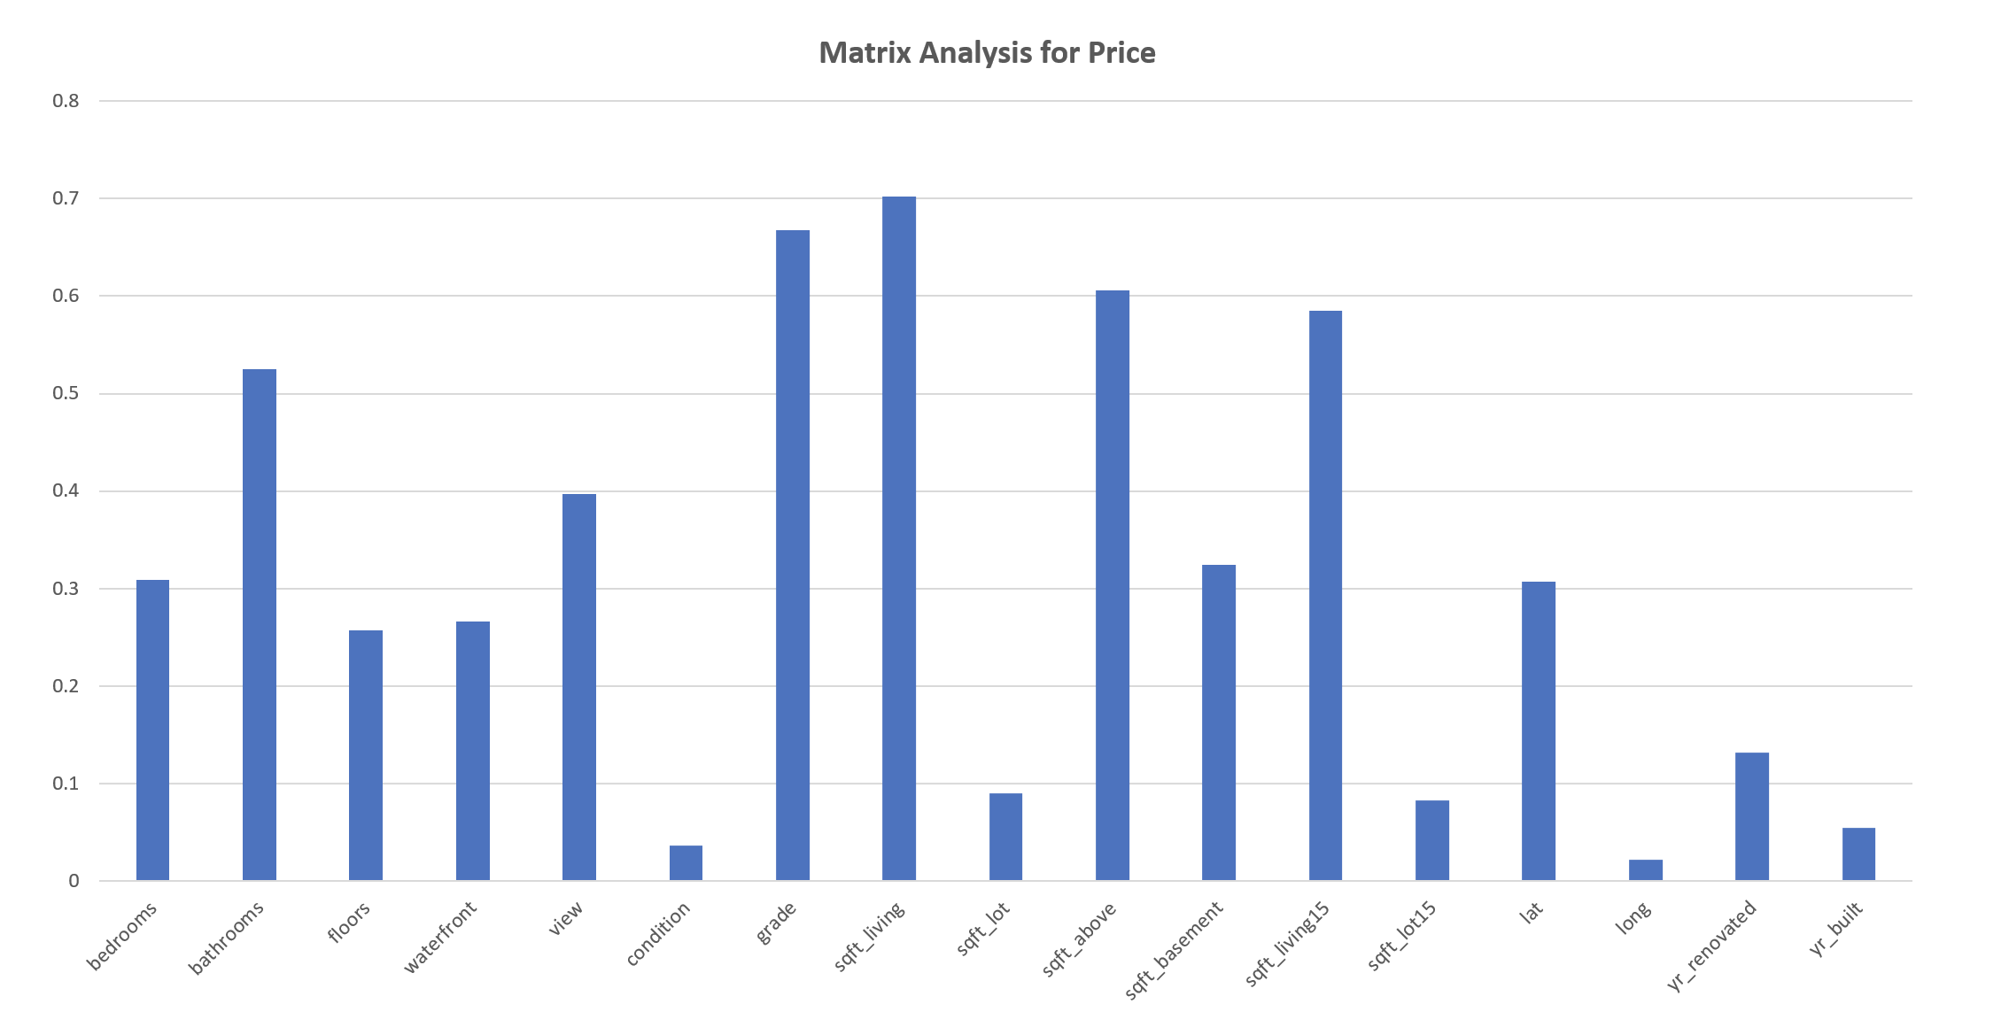
CORRELATION MATRIX
Highest correlation possible is 1.0.
Per the correlation analysis above, grade, sqft living, sqft above ground, bathrooms and view are important indicators of house price.

Slide 12
Regression Model Success
The model we built predicts price as an equation of independent variables bedrooms, bathrooms, floor, waterfront, view, condition, grade, sqft_living, sqft_lot, sqft_above, sqft_basement, lat, long
Predicted values show a similar trend with actual prices and the regression model is statistically successful.
Possible additional data fields for an improved model are listed in Appendix 2.

Slide 13
CONCLUSION
We should look at size of the house, number of bathrooms, building construction grade, if the house is waterfront to see how high the home prices should be.
Year renovated is more important than year built.
Our regression equation does a good job when predicting prices, and could perform better with additional data points and a bigger dataset.

Slide 14
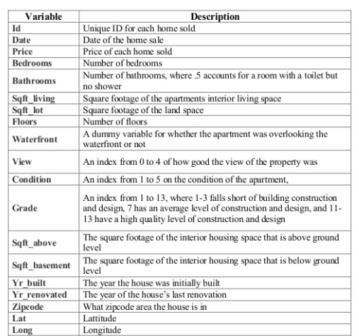
APPENDIX: FIELD DEFINITIONS

Slide 15
APPENDIX 2: OTHER POSSIBLE FACTORS
The economy
Inventory levels
Interest rates
Buyer demand
Home type (condo, etc.)
HOA cost per month
City Center or not?

